Slide 1
European School of Information Theory ESIT 2012 Antalya, Turkey

Slide 2
Organization
General Chairs:
Deniz Gunduz (CTTC, Spain)
Gerhard Kramer (TUM, Germany)
Local Organization
Alkan Soysal (Bahcesehir University, Turkey)
Dates: April 16-20, 2012
Location: Antalya, Turkey

Slide 3
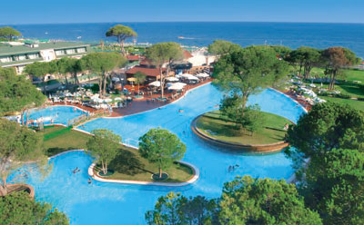
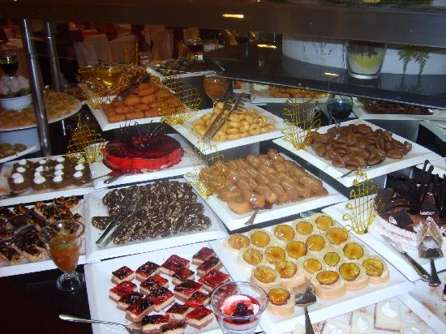
Location
Hotel Papillon AYSCHA, Belek, Antalya
450 Euros for double room, 590 Euros for single room
Package included all-inclusive hotel accommodation, airport transfers, half-day excursion, two coffee breaks per day.

Slide 4
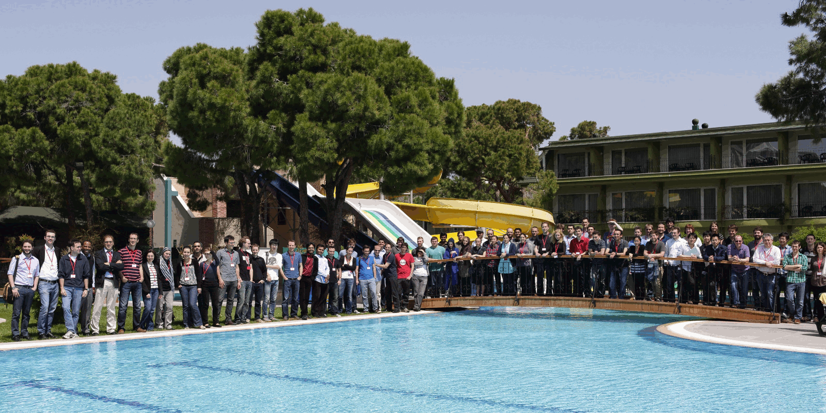
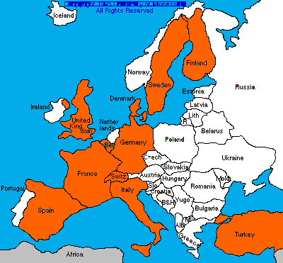
Students
Highest ever participation
74 students attended
From 25 institutions in 13 countries
Annual European school seems to be a good idea!

Slide 5
Program
Lecturers and Lecure Titles:
Frans Willems (Eindhoven University of Technology, Netherlands)
Introduction to Universal Source Coding and Biometrics
Michael Gastpar (UC Berkeley, USA and EPFL, Switzerland)
Algebraic Structure in Network Information Theory
Sennur Ulukus (University of Maryland, USA)
Information Theoretic Security
Gerhard Kramer (Technische Universität München, Germany)
Network Flow and Network Coding
Amos Lapidoth (ETHZ, Switzerland) (90 minute lecture)
Two by Gel'fand and Pinsker
Alex Dimakis (University of Southern California, USA)
Network Coding for Distributed Storage
(Meir Feder had to cancel for personal reasons. Gerhard Kramer kindly agreed to replace him.)
4 hours morning lecture + Student presentations in the afternoon

Slide 6
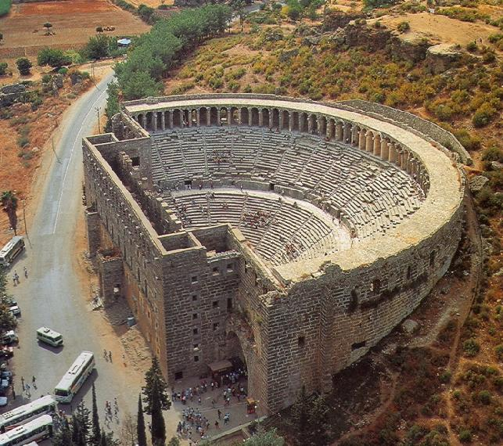
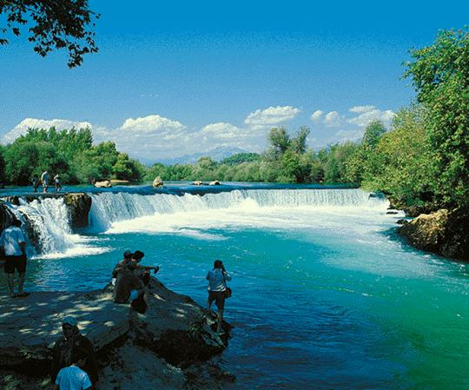
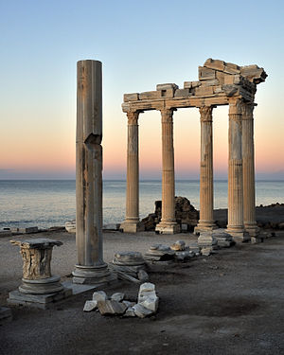
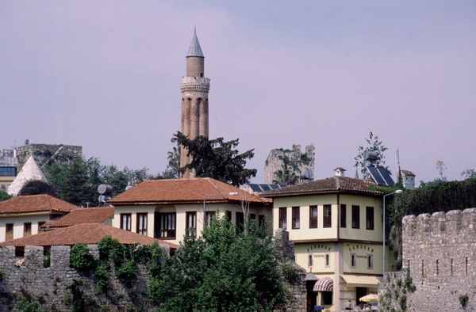
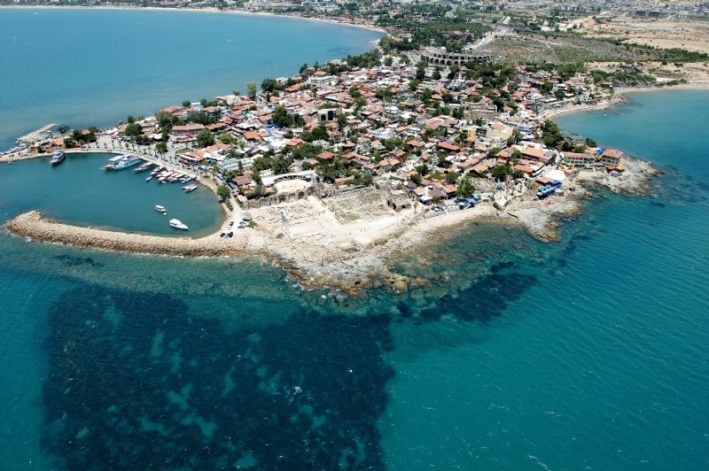
Sightseeing
Trip to nearby historical sites

Slide 7
Student Feedback: Satisfaction with ….

Slide 8
Feedback
Students mostly satisfied with the variety and the depth of the lectures.
Student presentations considered to be too short (~13 minutes).
For future organizations: Poster presentations would be better if possible logistically.

Slide 9
Budget
Received 16K Euros from IEEE IT Society
5K Euros for the accommodation of lecturers and organizers
1.5K for travel expenses (most lecturers paid for their travel expenses)

Slide 10
THANKS!
To the lecturers for their valuable time and effort (almost all funded their own travel).
To ITSOC for the valuable financial support which made the event possible.
To the students for their active participation.
To Matthieu Bloch for helping with the website.
To Angel Lozano for valuable feedback from the previous organization.
To Now Publishers for providing 4 issues of the Foundations and Trends in Communications and Information Theory to each participant.

