Slide 1
2012 North American School of Information Theory
Cornell University
Aaron Wagner & Salman Avestimehr

Slide 2
Timeline
School Dates: June 19 (Tue) – June 22 (Fri), 2012
  One week after ICC, two weeks before ISIT
Applications Due: March 30th, 2012
Decisions: April 16th, 2012
Registration Due: May 1st, 2012

Slide 3
Committees and Lecturers
Organization:
  General Chairs: Aaron Wagner and Salman Avestimehr
  TPC: Paul Cuff and Lav Varshney
  Publicity: Yingbin Liang
  Web: Bobak Nazer
  Advisor: Gerhard Kramer
Lecturers:
  Tom Richardson (Padovani Lecturer): coding theory
  Suhas Diggavi: wireless network security
  Elza Erkip: Shannon theory
  Pramod Viswanath: multi-user information theory

Slide 4
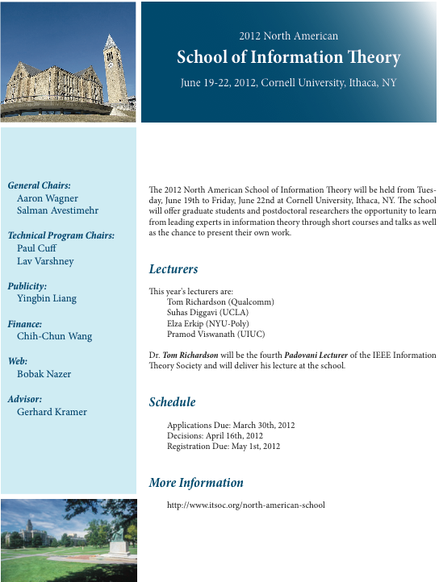
Publicity
Web: http://www.itsoc.org/north-american-school
Flyers will be distributed at ITA
Several publicity emails will be sent

Slide 5
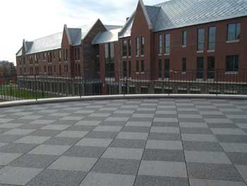
Lodging
Mews Hall
Students will stay in Mews Hall
  Cornell dorm built in 2000.
  Has A/C and WiFi
  $49/(person-night) with double occupancy
  Single occupancy available at $68/night
Lecturers will stay on campus in The Statler, the Hospitality School’s “teaching hotel.”
We are in the final stages of setting the contract

Slide 6
Meals
Breakfast & Dinner: all-you-care-to-eat cafeteria, near dorm
  Vegetarian options available
  Breakfast: $7.75 pp
  Dinner: $14.50 pp
Lunch: either box lunch near sessions ($11 pp) or cafeterias around campus (price TBD)
A sponsored banquet will replace one of the dinners

Slide 7
Estimated Cost
Assumes 125 student and 4 lecturers
Cornell Conference and Event Services will assist with logistics
  Feedback from 2011 school: get professional help!
  CES charges $33 pp fee
Goal: students only pay for transportation + a small registration fee 6 weeks ahead to show they are serious
Administration | $4K
Student Lodging | $25K
Student Meals | $15K
Banquet | $5K
Lecturers (all expenses) | $8K
Total | $57K

Slide 8
Fundraising
IT School: $20k
Cornell ECE Department: $20k
FoIE: $2k
IBM: $2k
Princeton: $500
We have submitted a proposal to ARO for $15k
We have also approached SU, SoI Center

Slide 9
Tentative Schedule
Applications Due: March 30th, 2012
Decisions: April 16th, 2012
Registration Due: May 1st, 2012
Day | Tuesday | Wednesday | Thursday | Friday
9 a.m. – Noon | 3 hr. lecture | 3 hr. lecture | 3 hr. lecture | 3 hr. lecture
2 p.m. – 5 p.m. | Student poster session | Student poster session | Student poster session
7 p.m. onwards | Breakout session | Free time | Banquet
We will work with the student society to generate ideas for other events: panel discussions, open problem brainstorming sessions, etc.
Wed. evening activities: hiking/waterfalls, wine tasting, Ithaca’s downtown pedestrian mall, ad-hoc soccer games, etc.

Slide 10
Suggestions?

Slide 11
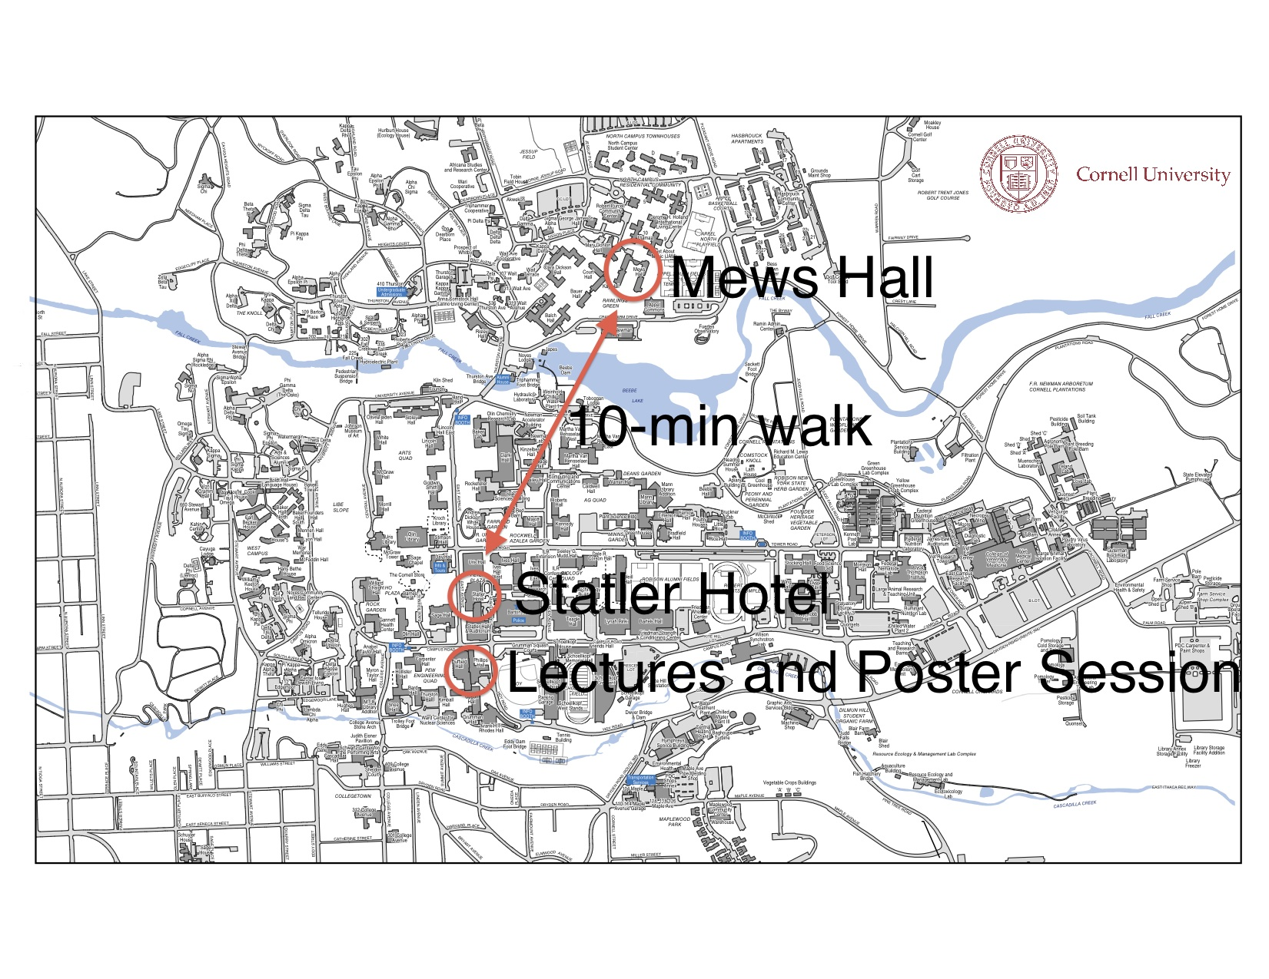
Facilities

