Slide 1
European School of Information Theory ESIT 2013
Ohrid
Republic of Macedonia

Slide 2
Organization
Organizing committee
Petar Popovski (Aalborg Uni, Denmark)
Zoran Utkovski (Uni. Goce Delcev, Shtip, R. of Macedonia)
Liljana Gavrilovska (Doctoral School of Electrical Engineering, Uni. Ss. Cyril and Methodius, Skopje, R. of Macedonia)
Dejan Vukobratovic (Uni. Novi Sad, Serbia)
Venceslav Kafedziski (IEEE Republic of Macedonia Section, Information Theory Society Chapter)
Advisory committee
Gerhard Kramer (TUM, Germany)
Deniz Gunduz (CTTC, Spain)
Dates: April 2013
Will use the ITSOC website as a platform)

Slide 3
Location: Ohrid, Republic of Macedonia
World Heritage city and lake
Good climate and tourist facilities
Very reasonable prices
Easily accessible from the major European cities
Major international airport in Skopje
Multiple cheap flights options starting from autumn 2012
A tourist agency takes care for transporting the people to Ohrid
Close to all the Balkan countries
Expect to receive many students from the region, especially ex-Yugoslavia

Slide 4
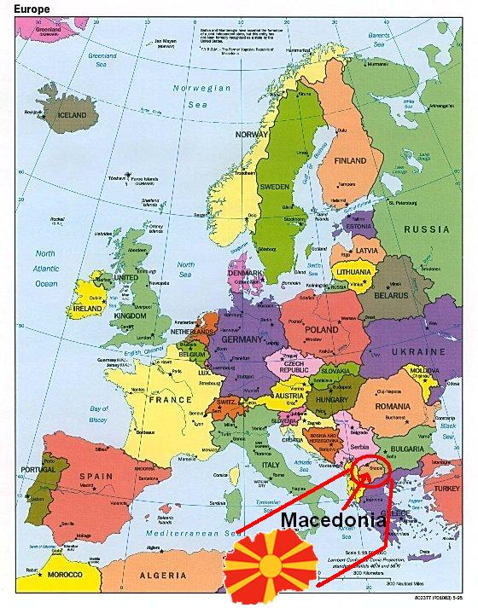
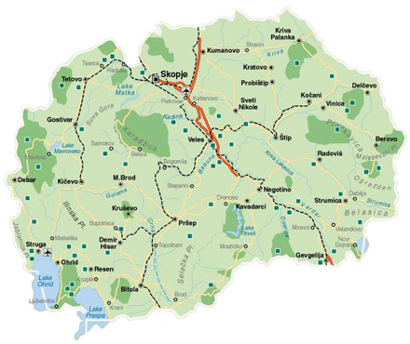
Location

Slide 5
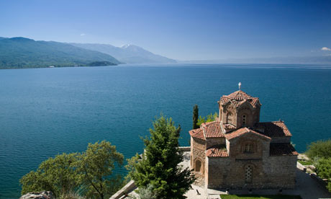
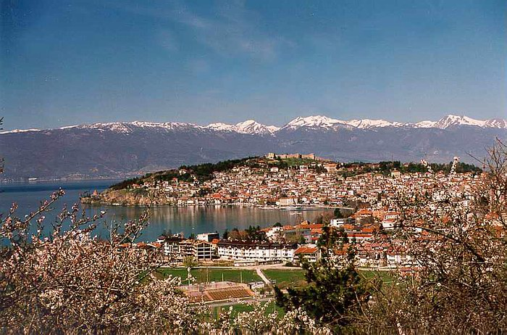
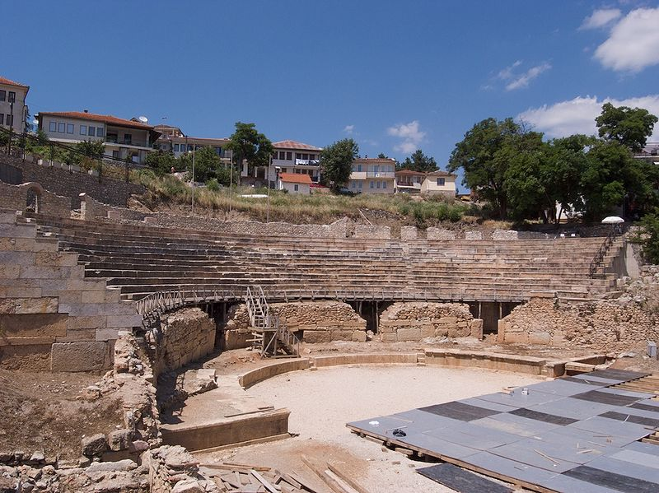
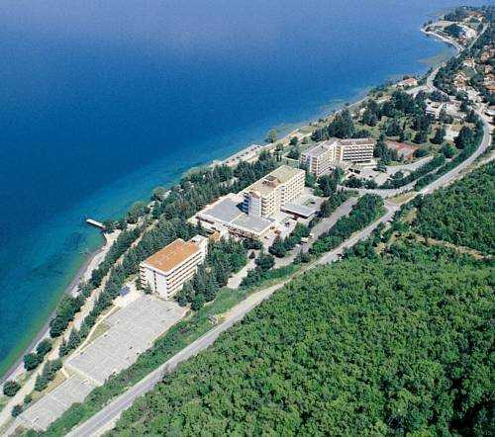
Location

Slide 6
Hotel Belvedere, Ohrid
€27 pp (double room), breakfast included
€40 (single room), breakfast included
Tax included
Lecture room included
No extra charge for projector, sound system
2 coffee breaks and lunch - €15 pp / day
Transfer Skopje Airp. – Ohrid – Skopje Airp. - €35 (on average)
Excursion - €25
Total cost student participant (5 nights) – €285

Slide 7
Hotel Metropol, Ohrid
€37 pp (double room), breakfast included
€45 (single room), breakfast included
Tax included
Lecture room included
Projector, sound system €50 / day
2 coffee breaks and lunch - €20 pp/ day
Transfer Skopje Airp. – Ohrid – Skopje Airp. - €35 pp (on average)
Excursion - €25
Total cost student participant (5 nights)- €360

Slide 8
Hotel Inex Gorica, Ohrid
€52 pp (double room), breakfast included
€65 (single room), breakfast included
Tax included
Lecture room €500 / day
Projector, sound system €200 / day
2 coffee breaks and lunch - €25 pp/ day
Transfer Skopje Airp. – Ohrid – Skopje Airp. - €35 pp (on average)
Excursion - €25
Total cost student participant (5 nights) - €470

Slide 9
Program
4 hour morning lectures for 5 days (Monday-Friday)
Student posters in the afternoon
Wednesday afternoon for sightseeing or activities

Slide 10
Estimated Cost (60 students)
Transfer + Lodging + Food + Excusrion:
Belvedere €17K / Metropol €21.5K / Inex Gorica €28K
Lecturers: €7K (lodging + flight)
Projector + sound system: €0 / €0.250K / €3.5K
Joint dinner for the participants: sponsorship required
TOTAL: €24 K / €28.75 K / €38.5 K
Student cost pp (lodging+meals+transfer+excursion) €285/ €360 / €470

Slide 11
Potential Financial Support
Local companies
EU support (no previous example)
Motion: that the ITSoc support the 2013 European School of Information Theory with a grant of $20K (or €14k)
Last year the grant was $20K
The price per student for all costs, excluding flight, was 450 EUR

